Slide 1

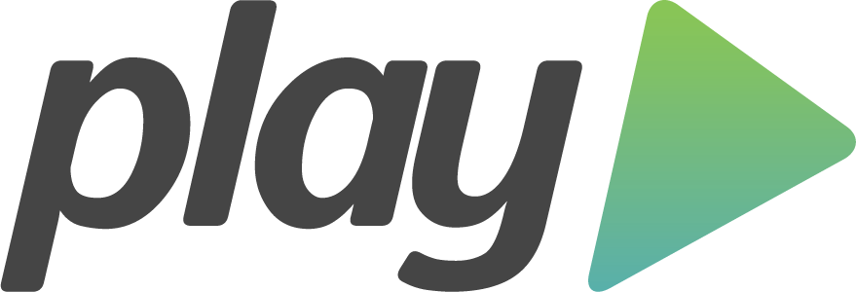
- take 2
History
Technologies
Who is using it?
How to create a new Play! App
Typical project structure
Play! MVC components
Examples
Notes:
What will I talk about?

Slide 2



History
Play! 1 first published in 2008
Play! 1 v1.0 released in Oct 2009
Created by Guillaume Bort (in Zenexity)
Other releases added support for Oauth, HTTPS, Scala
Play! 2 released in March 2012
part of stack
completely different framework
core written in Scala with Java API (not the other way around)
Ebean for persistance (not Hibernate)
Scala for templates (not Groovy)
Notes:
Guillaume Bort also known for being involved in development of Groovy.
OAuth – open standard to authorisation → allows users share private resources (f.ex. photos, films, contacts) stored on one website with another website without the need to provide credentials.
HTTPS – a communication protocol for secure communication over computer network. The main motivation for HTTPS is to prevent wiretapping and man-in-the-middle attacks.
Typesafe – company founded by Martin Odersky (creator of Scala)
Typesafe stack →
solution stack – a set of software subsystems or components needed to create a complete platform such that no additional software is needed to support applications

Slide 3
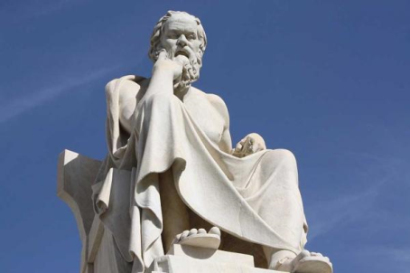
Philosophy
scaling horizontally can be cheaper and more flexible
web apps can be deployed anywhere if they are self managed and self hosted
web apps should be as stateless as possible to scale horizontally
apps need to be non-blocking to support high concurrency
Notes:
The creators of Play! Believe that…
- scaling horizontally →
self managed and self hosted → they provide their own small server that can accommodate single application
stateless →
concurrency →

Slide 4

Technologies
Play executable and Play framework
Play framework libraries:
Netty (web server)
Akka
Logback
Views
CoffeScript and LESS
WebSockets and Server-Sent Events
JDBC and JPA ORM
ORM: Ebean
H2 in-memory database
Junit and Selenium
components can be overwritten
Notes:
Play! consists of many common libraries and technologies
Play executable and Play framework
Play executable
is a command line tool (u can create, run, test apps and also package apps for deployment as standalone executable jars)
consists of a few JVM-based tools and SBT
There are a range of technologies under the hood. Play! is self-hosted; this means rather than having to deploy a web container, it will run its own dedicated HTTP server per application. It will use Netty to do so.
Netty is a non-blocking I/O (NIO) client-server framework for the development of Java network applications such as protocol servers and clients
The core of Play! code is built on top of Akka, a toolkit for creating concurrent applications on the JVM. Akka allows to create actors that send messages.
Logging in Play! is provided by Logback, a popular Java-based logging framework.
Views are Scala based and they get compiled -> this gives type safety and compile-time checking of syntax
Play! supports cient-side technologies such as CoffeeScript and LESS
Play! Supports server-side technologies such as WebSockets and Server-Sent Events
JDBC Java DataBase Connectivity - łącze do baz danych w języku Java → This technology is an API for the Java programming language that defines how a client may access a database. It provides methods for querying and updating data in a database.
JPA – official ORM for Java
Junit and Selenium - there's no particular obligation to use these technologies. They're provided for completeness.

Slide 5





Who is using it?
Notes:
Klout is a website and mobile app that uses social media analytics to rank its users according to online social influence via the "Klout Score", which is a numerical value between 1 and 100. In determining the user score, Klout measures the size of a user's social media network and correlates the content created to measure how other users interact with that content.

Slide 6

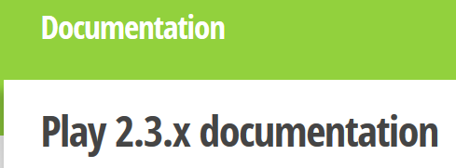

Before new app is created
download binaries
and dependencies
documentation
tutorial
link to external websites
add play to path
Notes:
Binaries → When downloading, a completely functional program without any installer is also often called a program binary, or binaries (as opposed to the source code).
External links: twitter, github, stackoverflow…

Slide 7
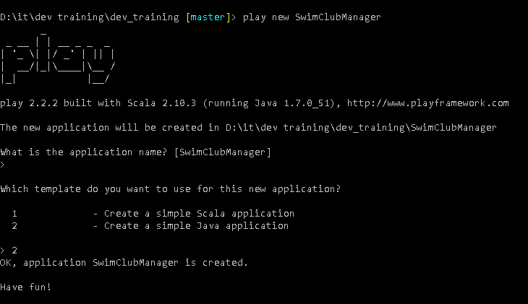
Create new app
Notes:
command: play new SwimClubManager → creates new app
Choose template:
1 – Scala
2 – Java

Slide 8




compiles and builds the application
by default on port 9000
Play! supports hot deployment
play compile, play test
IDE support - commands:
- play eclipse
- play idea
Notes:
Hot deployment → you refresh the page in your web browser and changes are applied, you don’t have to stop the run of the application and compile it again every time you make a change + descriptive error handling
play compile command allows to just compile the code.
play test will test your application → the template comes with 2 tests – a unit test and an integration test
play eclipse/idea → Created the necessary files to open, run and edit a Play application

Slide 9
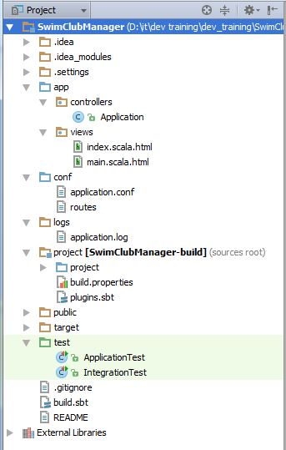
Project structure
app
controllers
views
conf
application.conf
routes
project
public
test
Notes:
app folder
- primary location to store the application source code
- it contains controllers, views, and model code
- it is convention and u can break out of this convention but it may need some configuration changes
conf folder
- holds non-source files that relate to the configuration of the application
- this includes application.conf file, the default and primary source for configuration data in the application
- also contains routes file, which is the central definition of all routes or endpoints of the application and their respected parameters
project folder
- contains files that are used to define the project and configuration necessary to build and run the application
- the build file is actually a Scala file, cos the underlying build system is SBT; the Simple Build Tool, which uses Scala and a Scala-like DSL for build definitions
public folder
- holds all the static assets that your application will want to serve, such as images, javascripts, and CSS
test folder
- default place to create any tests
- can be Ats, UTs…
- can include any test-specific resources you may need as well

Slide 10
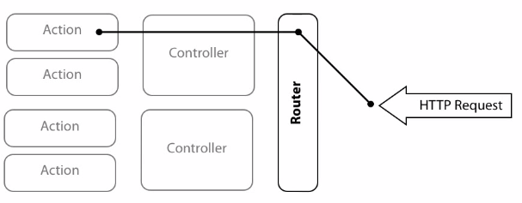
Router mechanics
GET, POST, PUT, DELETE
www.myapplication.com/customer/1/order/2
Notes:
router
- inspects various aspects of the incoming HTTP requests
- routes he requests to a specific action of a specific controller
- router is like a single responsibility principle in programming, the alternative to a router would be a huge if statement that would have a branch for every possible acceptable route
the router translates incoming HTTP requests into a specific controller action
how?
It looks at the HTTP method (verb) and the request path.
Method is the intent of the request:
GET – retrieve data
POST – create data
PUT - update data
DELETE – delete data
so… they represent basic CRUD operations in your application. Of course, you can use other HTTP methods…
Path consists of 2 parts:
- the first part is responsible for making sure your request gets to your server and web application through the internet, which would be www.myapplication.com
- the second part is used by your web application to determine what action to get executed, which would be /customer/1/order/2

Slide 11
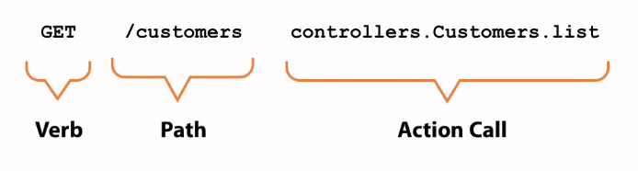
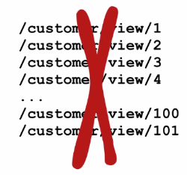
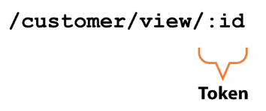
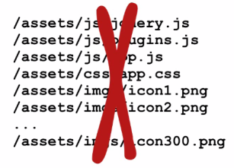
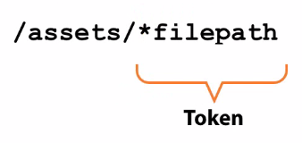
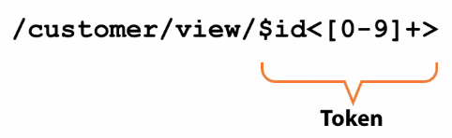
Routes in Play!
“Call the Customers controller list action when a GET request is made to the /customers route”
token
clobbing
regular expressions
Notes:
Routes in Play! are declared using a DSL
A basic route declaration is composed of 3 main parts:
- the HTTP Verb or Method
- the Path or URI pattern
- the Call to the Action itself
The path is called a URI pattern as it can catch more than just one path:
- static route, i.e. /customers will point to that specific route
- dynamic route, i.e. /customers/:id/order/:orderId will point to a different route depending on the id and orderId
You wouldn’t define a separate route for each customer /customer/view/1, /customer/view/2 etc…
So that’s why you would use tokens.
There are other ways of extracting data from a URI path:
- clobbing – neither static, nor dynamic fits
- regular expressions – id can only be numeric so if u pass a non-numeric value, u will get a 404 Not Found response, instead of an error (nicer error handling), but downside is – if we change our code then the path has to be changed too.

Slide 12
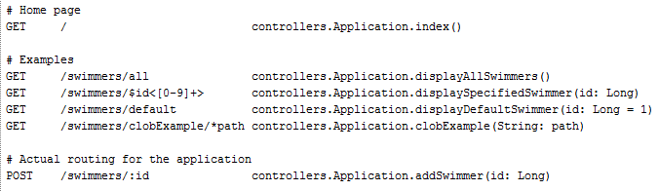
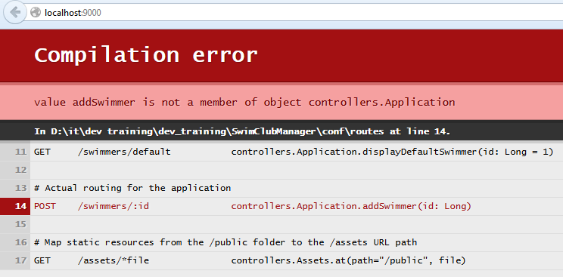
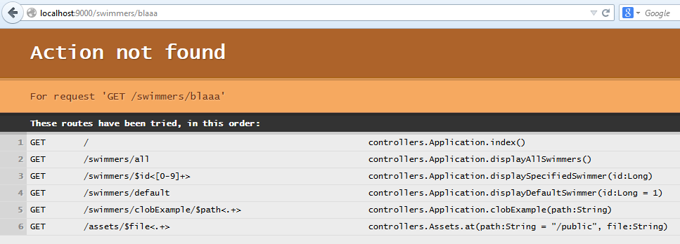
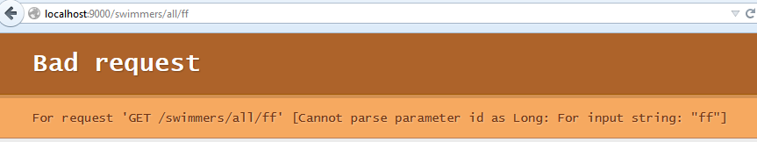
Routing in action
Notes:
In Play!, Actions are defined as static methods on controller classes.
A few routes that demonstrate the various aspects of Play!'s routing capability.
A basic controller with a number of actions that match up to these routes.
Run the application
Error – why? POST has no corresponding action → comment it out → run again
Type in all possible combinations of routes
Type in incorrect route and u will get an “action not found” error which in Development mode actually lists all of the defined routes.
Type in /swimmers/9 and u will get a bad request
Type in /swimmers/clobExample/bala****jsjddk////// and it will be all displayed exactly like that

Slide 13
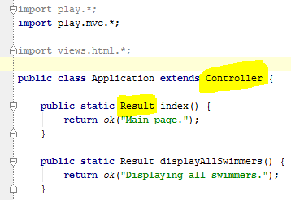
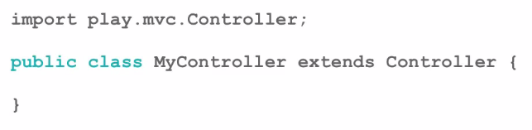
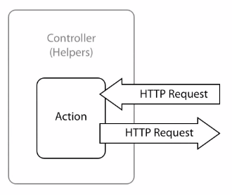
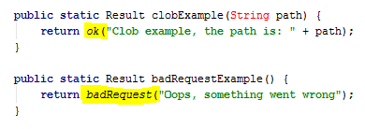
Controllers and actions
Notes:
Controllers in Play! provide an environment in which Actions can operate.
In Play! Most of the work related to handling responses is pushed to Action and Result classes.
The contract for Controller is simply a class that implements the Controller abstract base class.
In Play!, Actions deal with HTTP Requests. Actions are implemented as static methods on the Controller.
They operate on a Request object, a codified abstraction of the actual HTTP Request.
They return a Result object, a codified abstraction of an HTTP Response.
Result object provides an HTTP status and the content of a response.
Controller class provides helpers that make defining these properties (HTTP status code and response content) extremely simple.
ok and badRequest are examples of these helper builders, Play! provides around 13 of them, but you can define your own (418, “Im a teapot”);

Slide 14
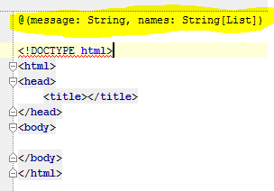
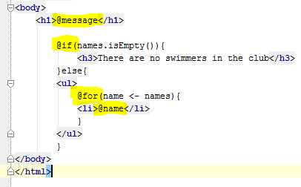
Views
views are Scala:
you can express logic in views
type safety
compile time syntax checking
views have double extension .scala.html
partial views
and layouts
Notes:
Type safety - apparently it is very uncommon in other MVC frameworks?
The highlighted portion is Scala syntax in views → so u don’t have to know Scala to use Play! 2, but u do a bit... ;)
So what is that @message symbol? It means u pass a String from a Controller.
The @ symbol differentiates between HTML and code. So u indicate code by the @ symbol.
- examples:
- @message
- @names
- @if
There is this concept of partial views and layout where u pass in one view into another, because views are basically just code, so the idea is code reuse.

Slide 15
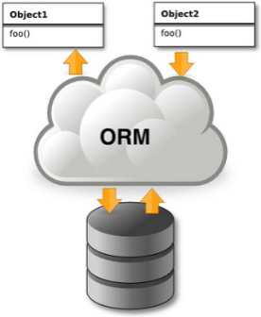
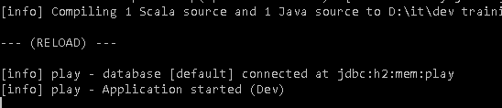
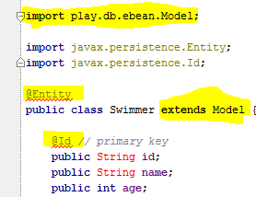
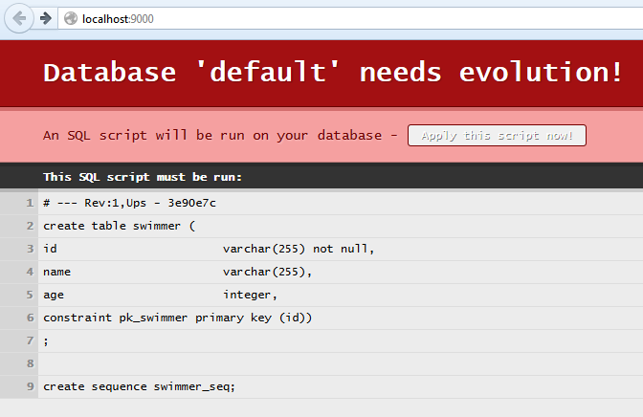
Database access
Ebean ORM
H2 in-memory database
Notes:
Uncomment Ebean in our application.conf
mark up our domain object (Swimmer) to identify it as an entity using @Entity attribute
Our domain object (Swimmer) inherits from Model (a base class for Ebean models that make the basic CRUD operations available on the model instance itself)
specify the id field that will be used for indexing of entities and during queries.
“Database needs evolution” looks like an error → what happened?
a folder called evolutions/default has been created in our conf folder
It contains a single SQL script that contains a table declaration for our entity
Play! provides an optional database evolution mechanism that gets triggered when this folder evolutions exists
It will use each subfolder as a data source and attempt to apply evolutions to that data source
Default is the name of our H2 database
Evolutions are generic strategies for handling evolving schemas → any schema changes to be made should be done in a new evolution file using the next number in the sequence as a file name
AND if u delete the folder evolutions/default what Ebean does when it is ran, if none exists, is generate a schema evolution based on the current domain

Slide 16
Database model in views
Finder class
Notes:
Finder is a convenient wrapper around Ebean's query interface and lets you build structured queries for accessing entities
The common implementation pattern is to declare a Finder as a static property on the entity it is related to
The type signature of Finder takes an id type and an entity type. In our case, the id type is Long and the entity it's going to return is a Swimmer
The find property we just created then gives us access to a query mechanism for building dynamic queries against our domain model
It also provides a number of convenience methods that we can use to avoid having to build up common queries

Slide 17


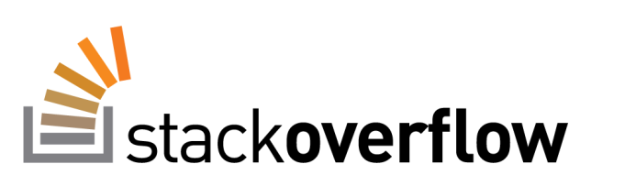
Based on course by James
Hughes
and
and

